Slide 1

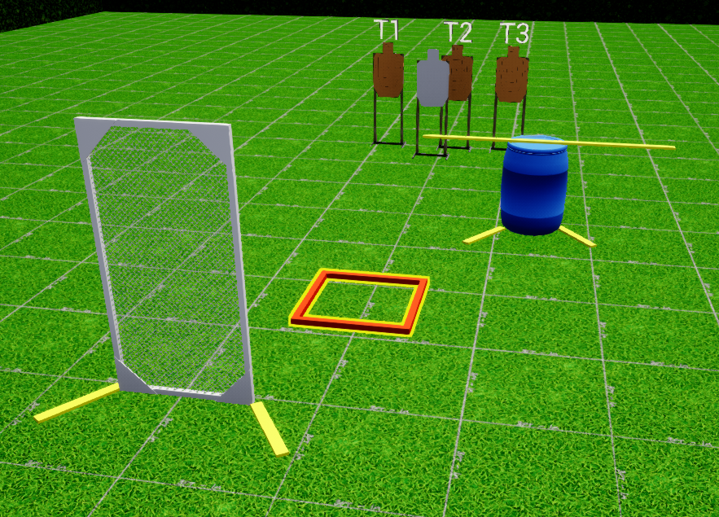
 | Interlake Sporting Association North Pistol, A Stage: High or Low Course Designer: Peter Jarvis
START POSITION: Standing in start box. Handgun loaded and holstered, wrists below belt. PCC loaded with safety on, stock on belt muzzle pointed downrange. |  | STRINGS: 1 SCORING: Unlimited/Limited SCORED HITS: Best 2 ROUND COUNT: X TARGETS: 5 IDPA, 1 NT, 1 PP START-STOP: Audible - Last shot CONCEALMENT: Required Muzzle Safe Points: Muzzle safe markers / 180 degree rule SO NOTES:
STAGE PROCEDURE: String 1: At the start signal, engage T1-T3 from either P1 or the low cover of P2, then move to the other position and reengage T1-T3. String 2: At the start signal, move to the opposite position you moved first to on String 1, engage T1-T3. Then move to the other position and reengage T1-T3.
P2
start
P1

